Slide 1
Deep Learning with PyTorch
Seth Juarez
@sethjuarez

Slide 2

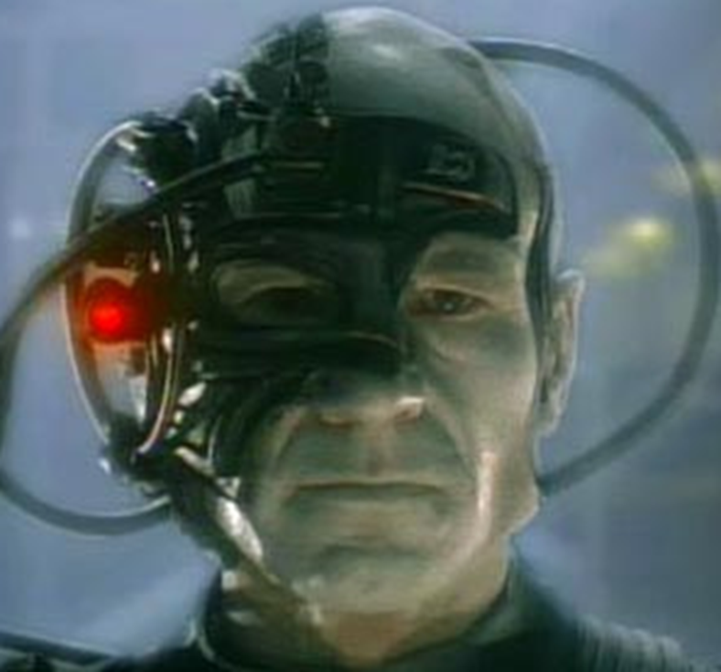


Slide 3


Slide 4
artificial intelligence
machine learning
deep learning

Slide 5

programming
algorithm
answers
input

Slide 6
machine learning
answers
algorithm
input

Slide 7

machine learning
PyTorch
model
data

Slide 8

machine learning
data
PyTorch
model / algorithm
code
answers
input

Slide 9


Slide 10
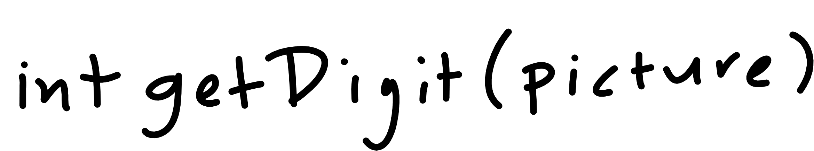

Slide 11
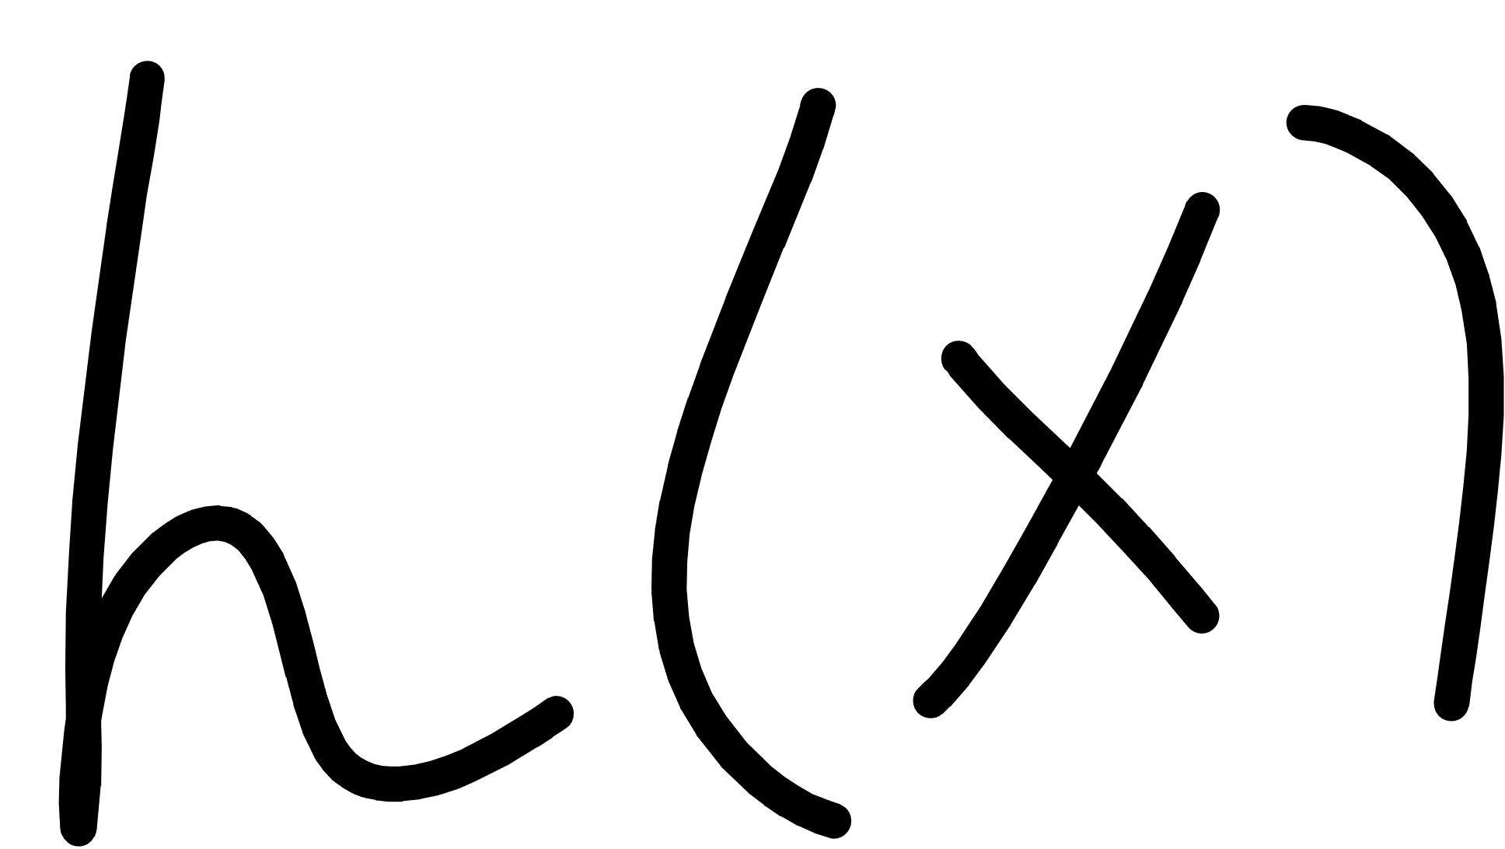
Notes:
Cover the fact that ML uses data to make its own functions

Slide 12
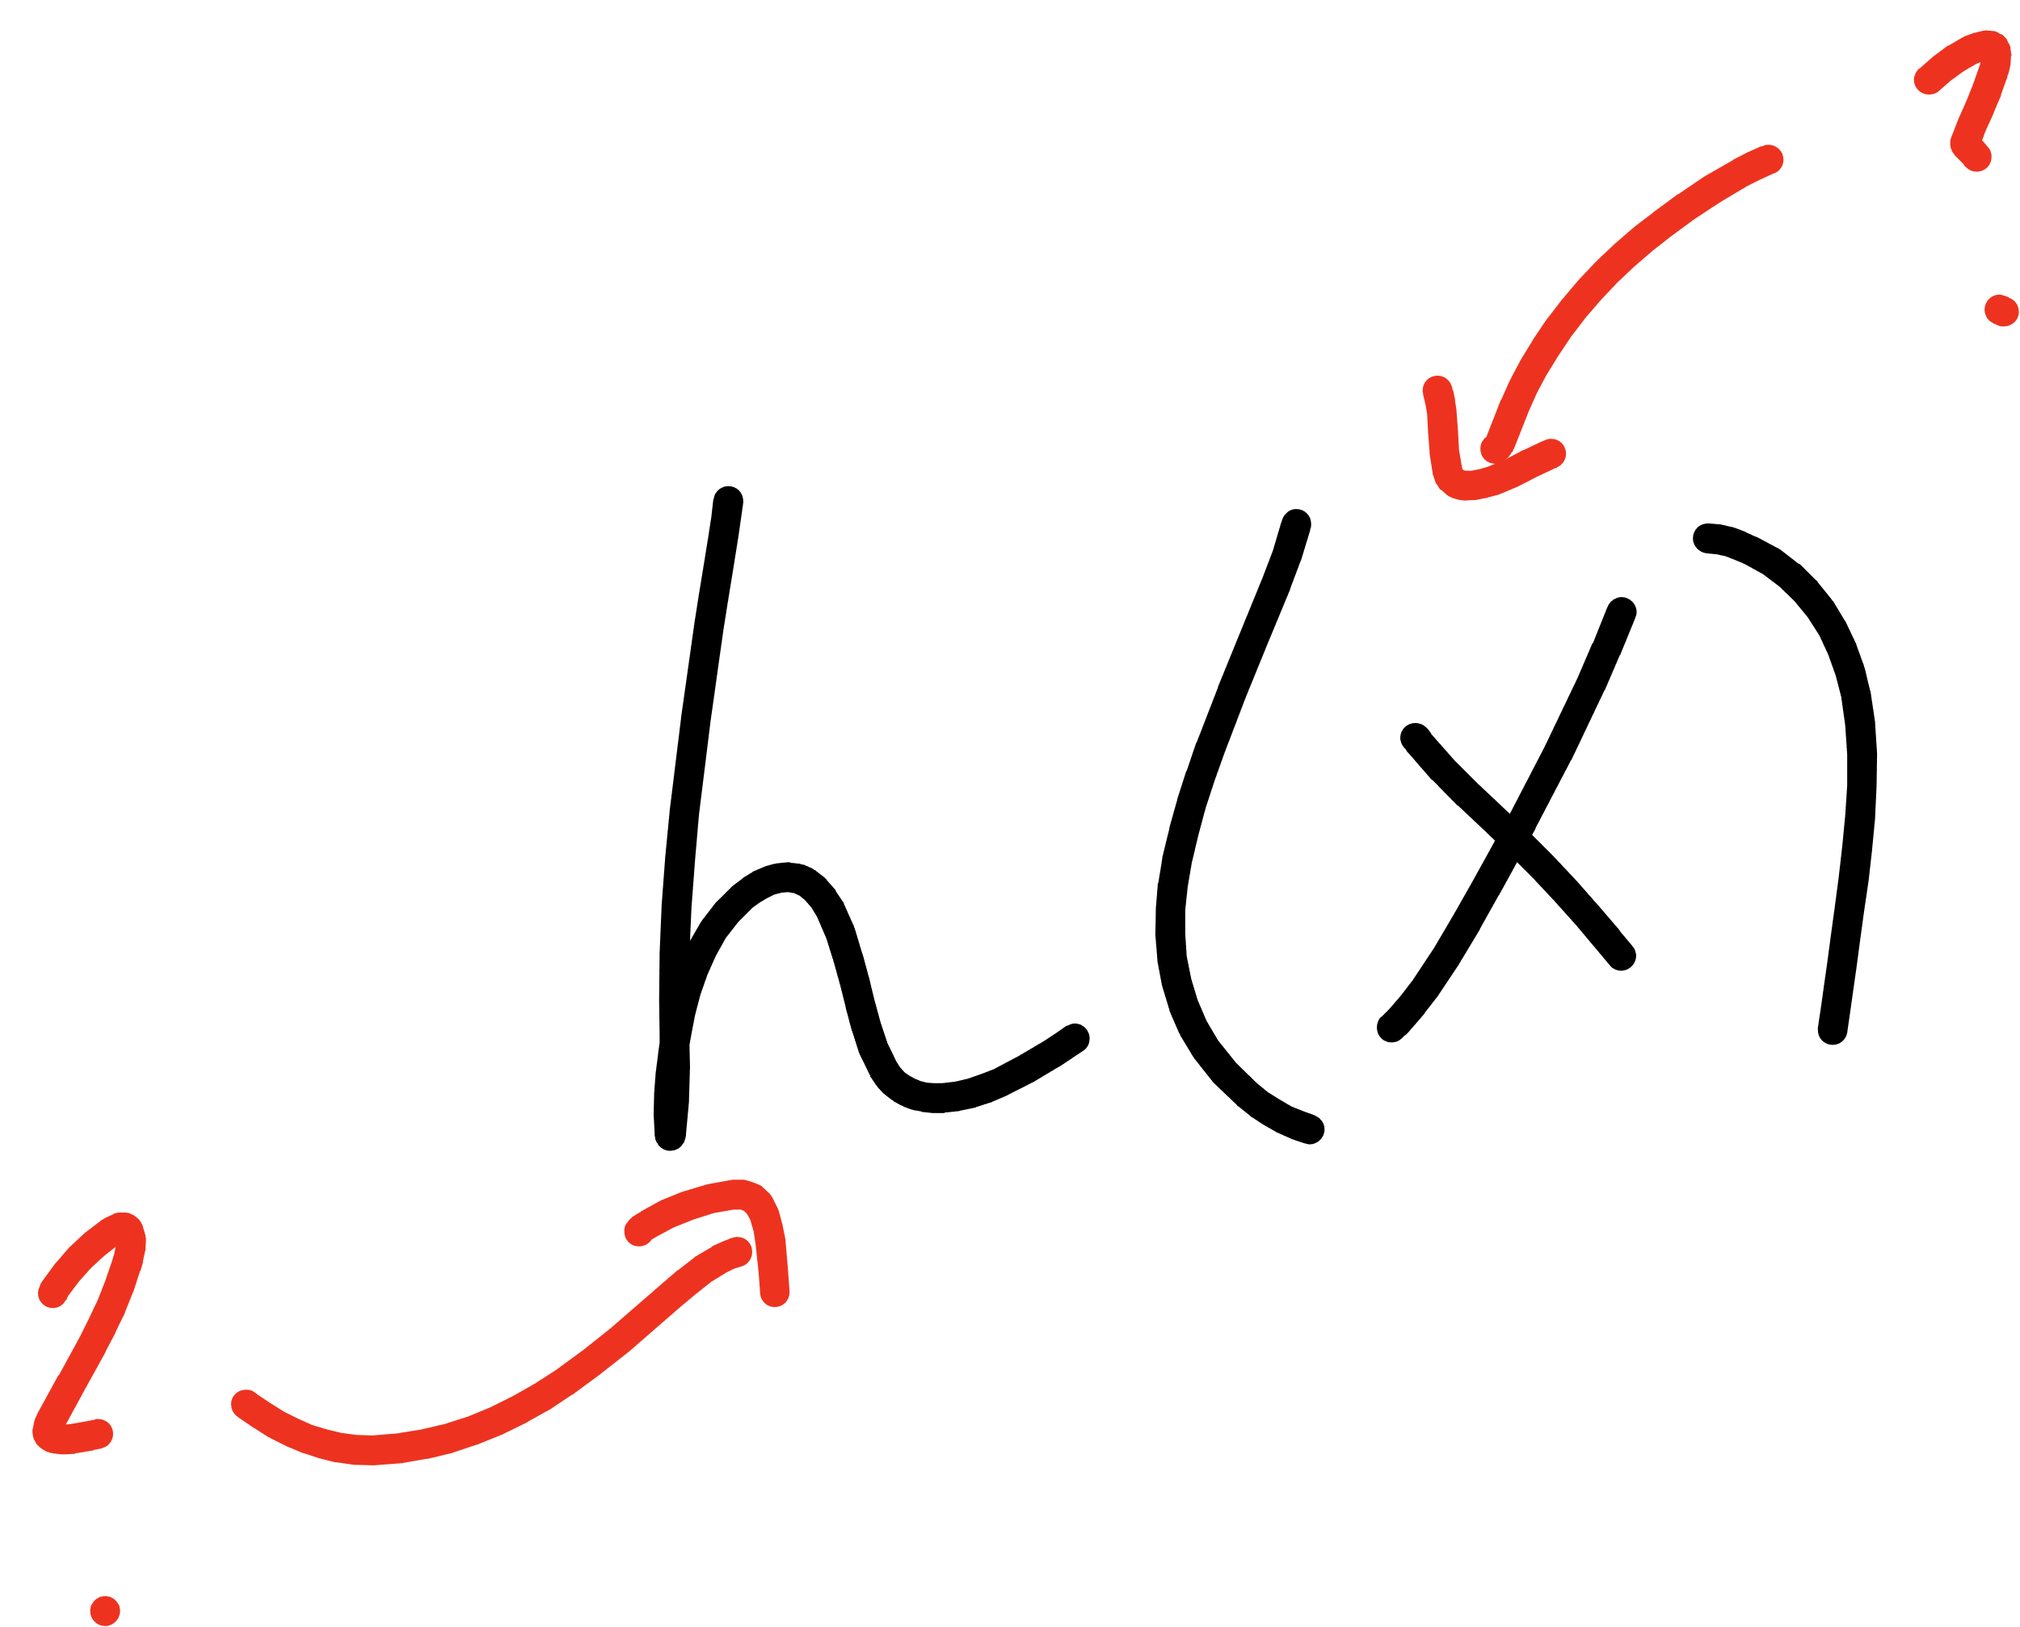
Notes:
Open mnist data representation

Slide 13
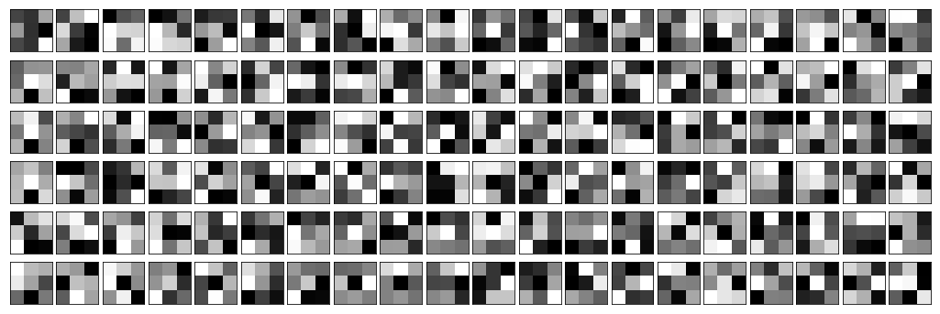
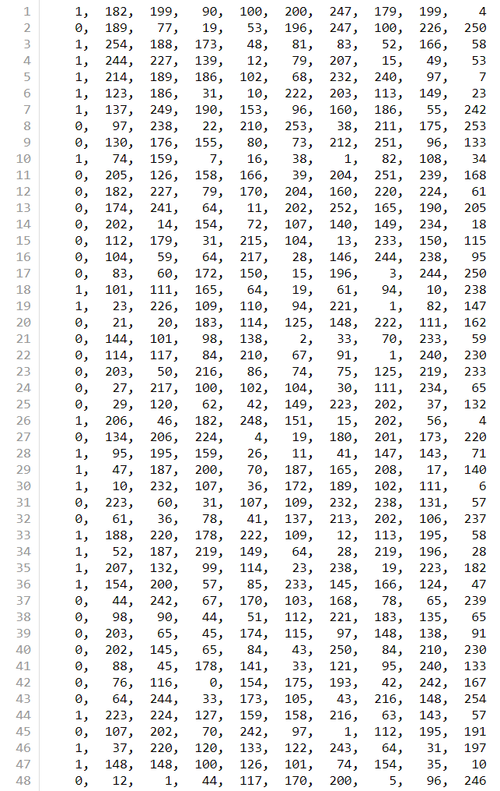


Slide 14
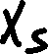
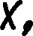
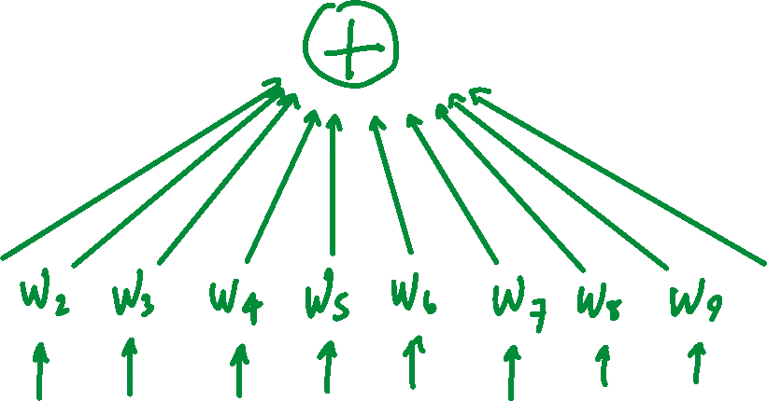
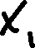

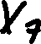

Slide 15
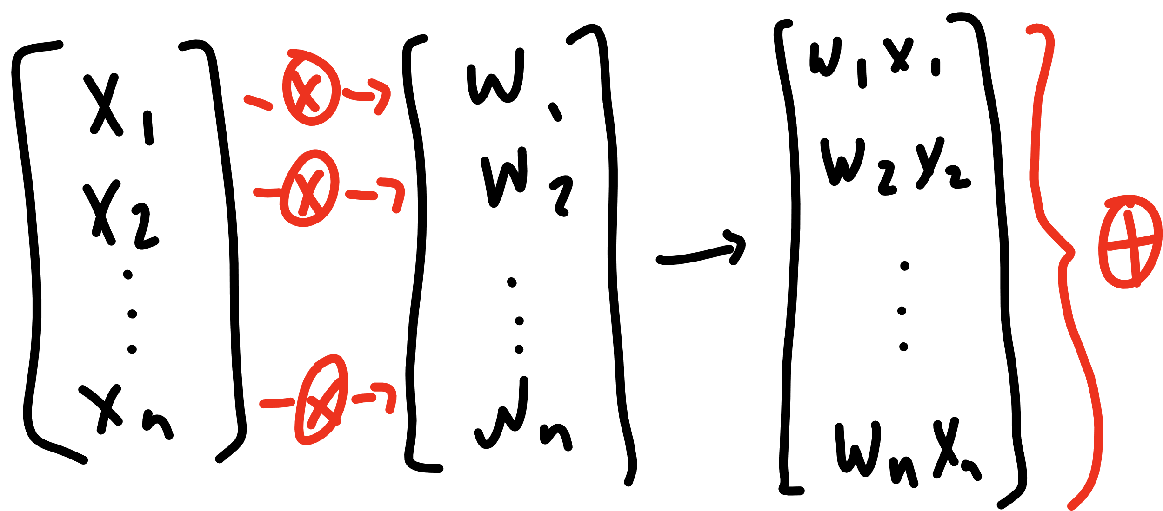

Slide 16
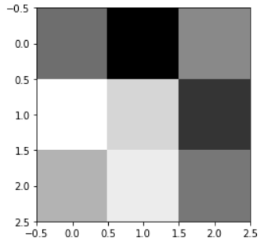
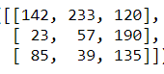
[142, 233, 120, 23, 57, 190, 85, 39, 135]

Slide 17
[ 1, 1, 1, 0, 0, 0, -1, -1, -1]
[142, 233, 120, 23, 57, 190, 85, 39, 135]
236

Slide 18
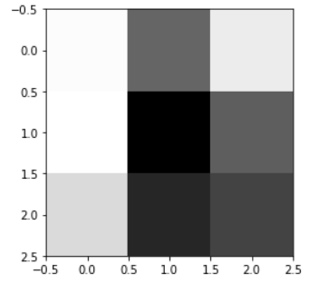
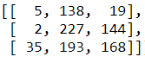
[5, 138, 19, 2, 227, 144, 35, 193, 168]

Slide 19
[ 1, 1, 1, 0, 0, 0, -1, -1, -1]
[5, 138, 19, 2, 227, 144, 35, 193, 168]
-234

Slide 20
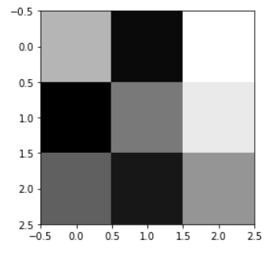











Slide 21






Slide 22












Slide 23










Slide 24

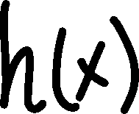







Slide 25











Slide 26
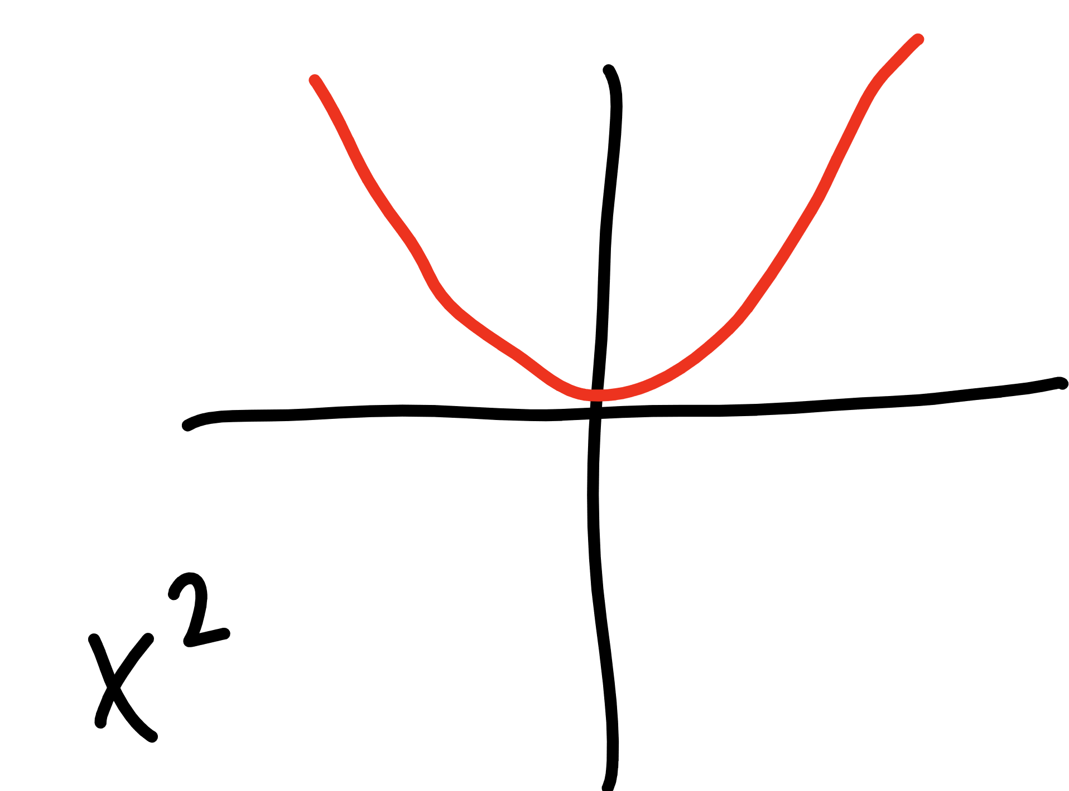

Slide 27
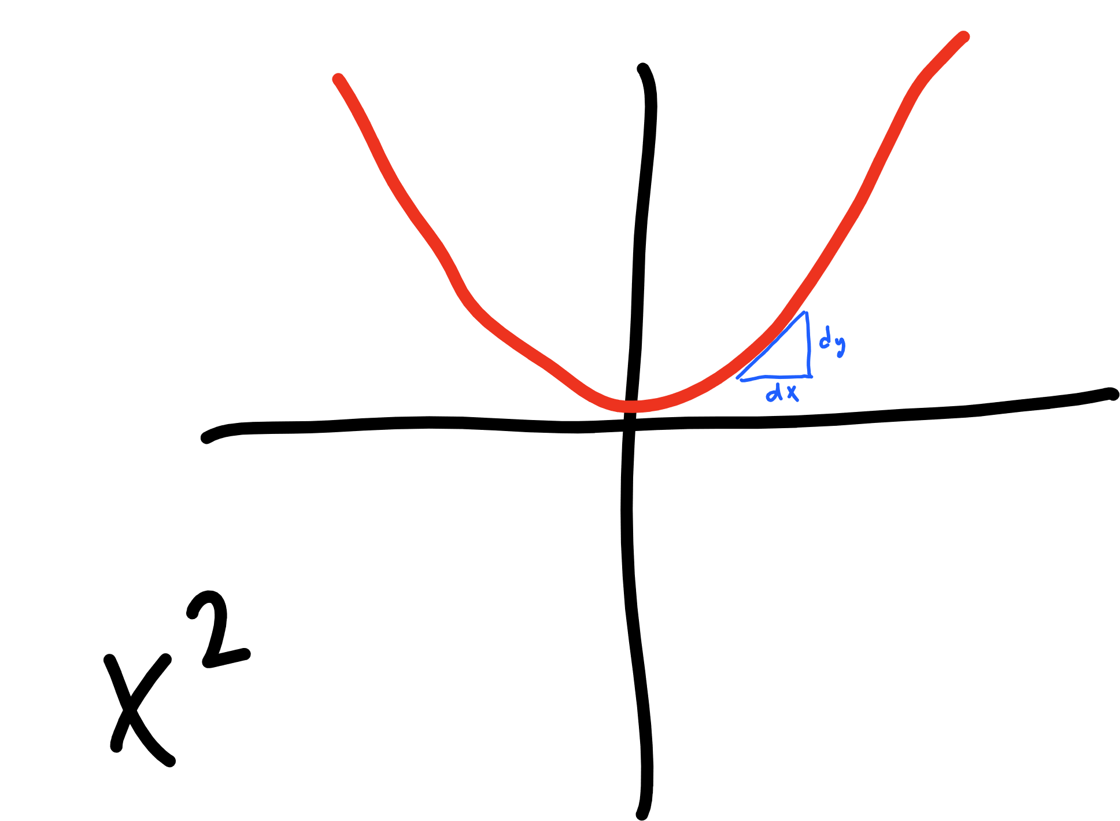

Slide 28
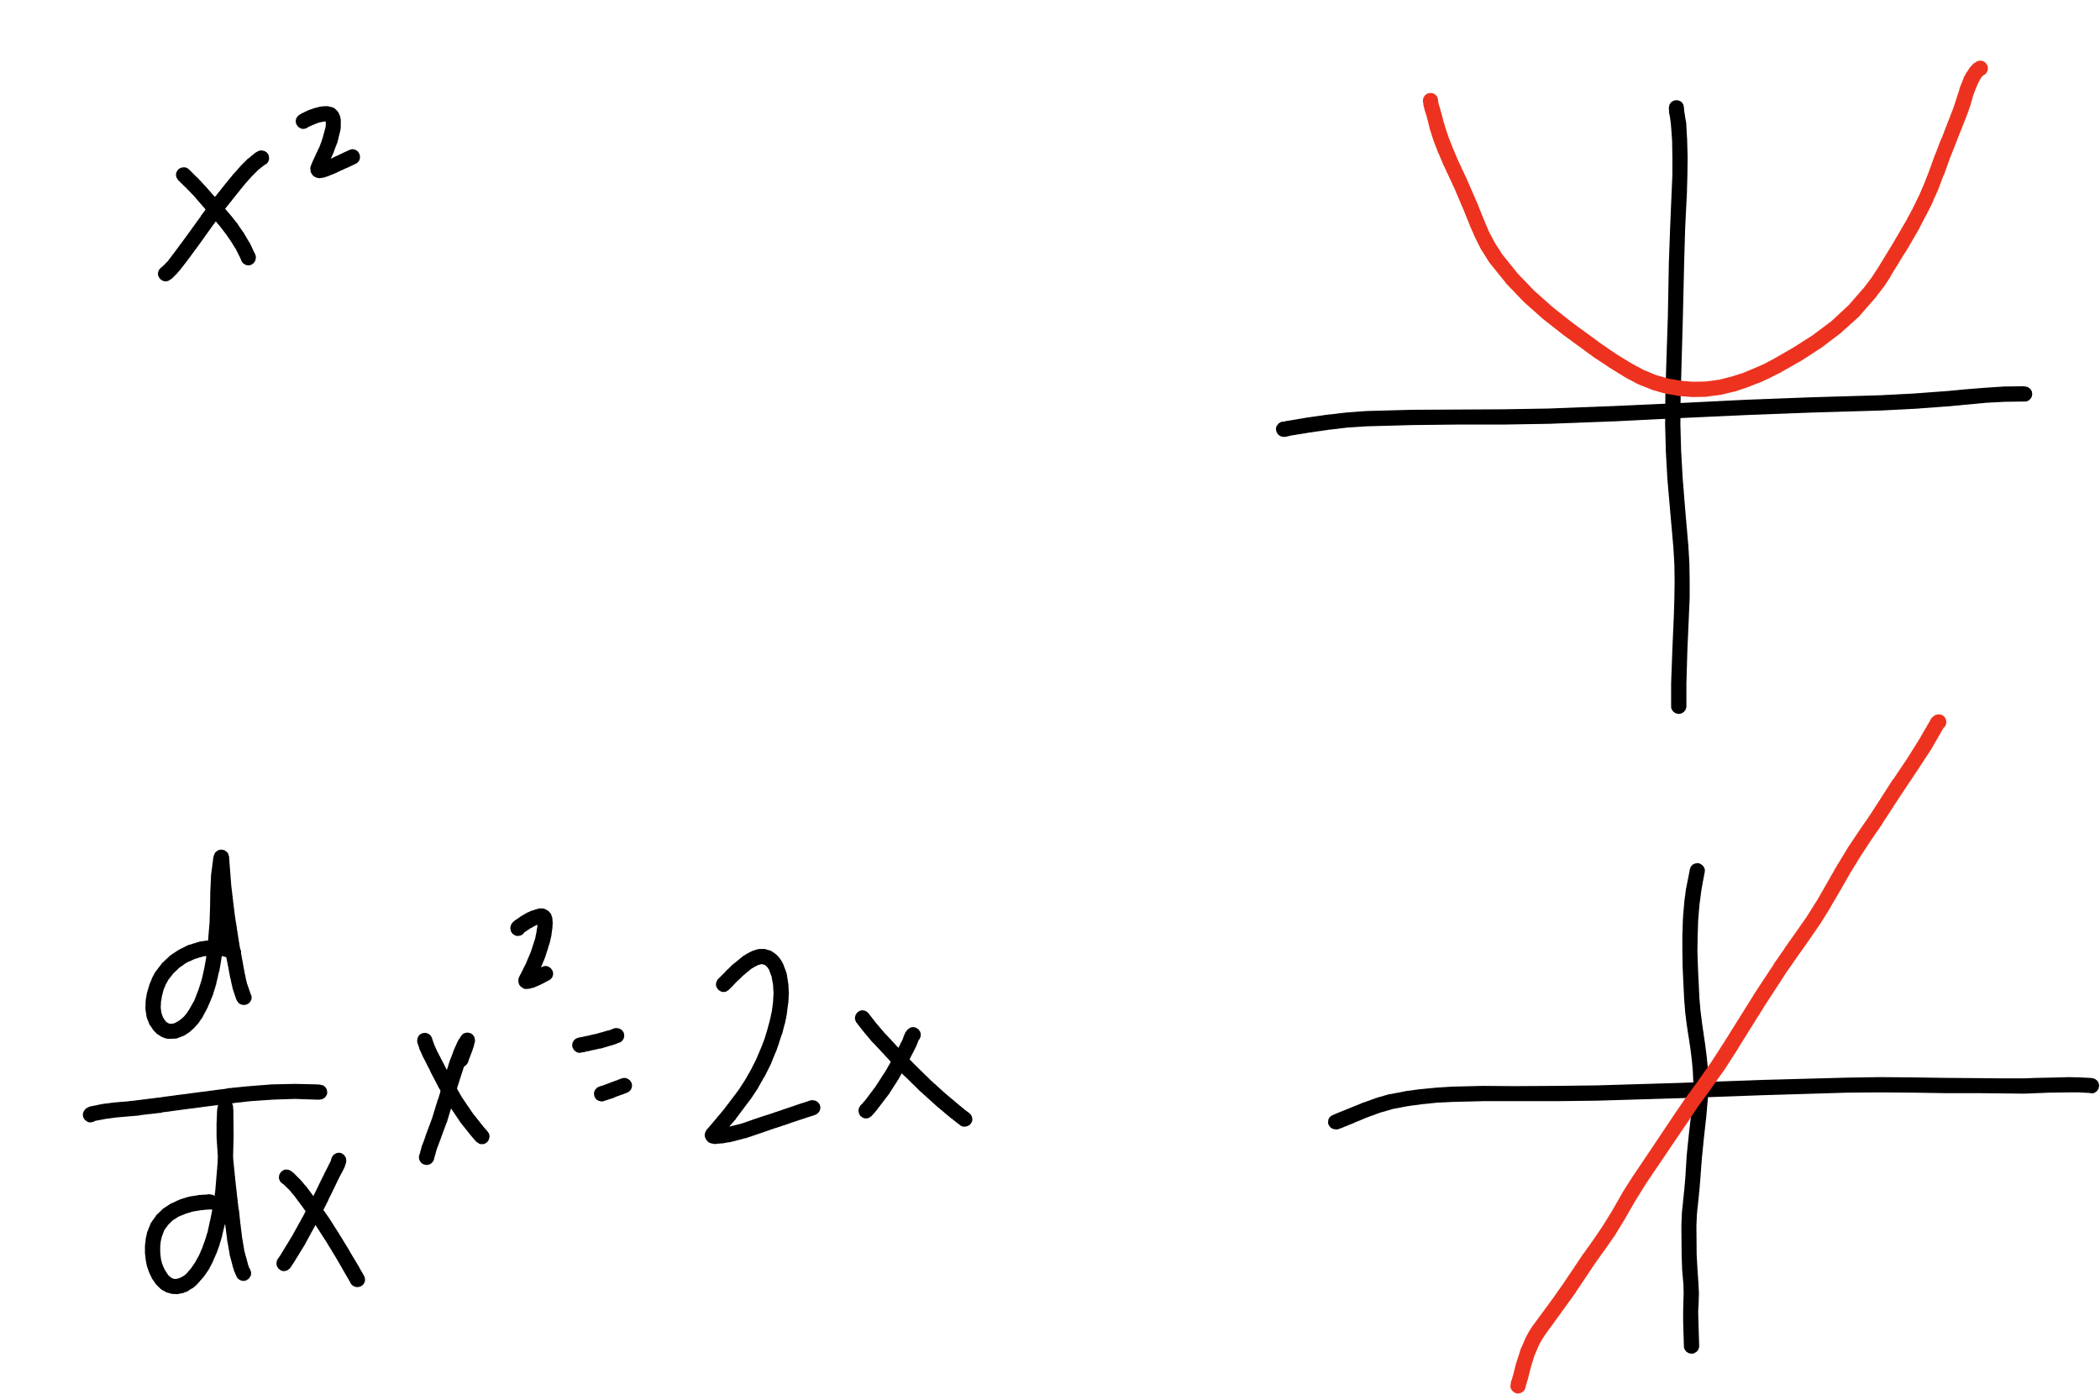


Slide 29







learning
rate
updated W
derivative of
cost function
current W

Slide 30

learning
rate
gradient of
cost function
updated W
current W

Slide 31








learning
rate
gradient of
cost function
updated W
current W

Slide 32


learning
rate
gradient of
cost function
updated b
current b

Slide 33
Let’s try it out!
simple numpy sanity check

Slide 34
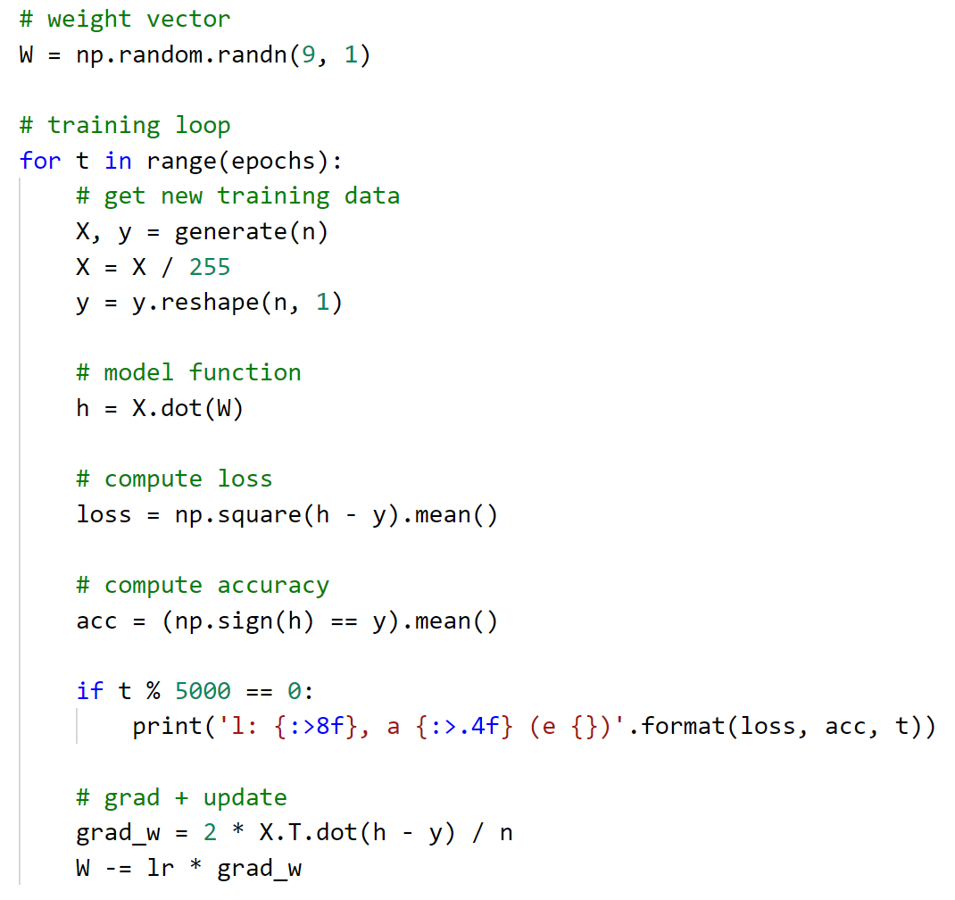
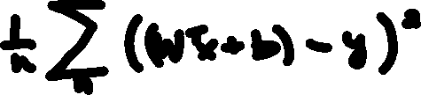
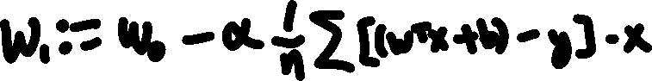

Slide 35



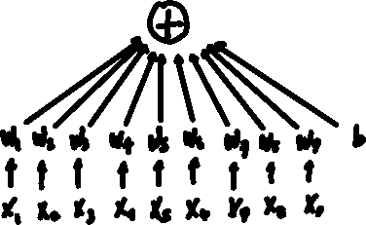

top
middle
bottom

Slide 36
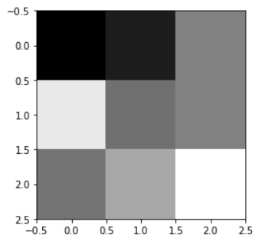
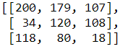




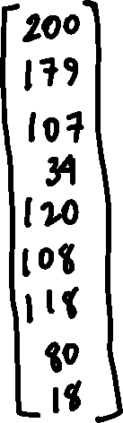


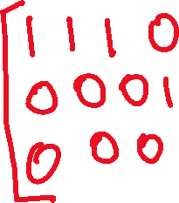
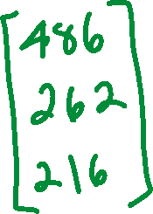

Slide 37






Slide 38
Let’s try it out – PART DEUX!
simple numpy sanity check

Slide 39
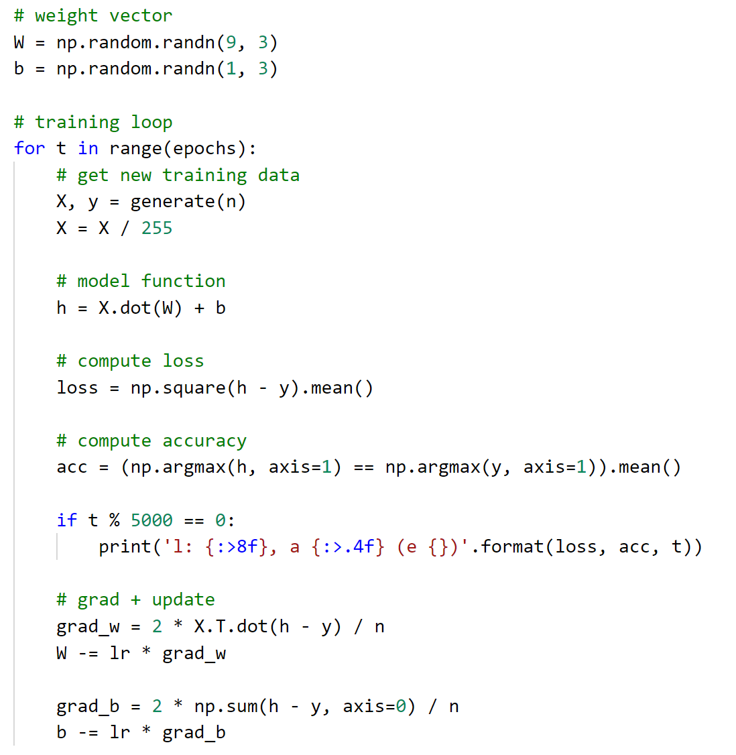


Slide 40


Slide 41


Slide 42
PyTorch
Why not just use numpy?

Slide 43
PyTorch
Tensors
DataSets
DataLoaders

Slide 44
Let’s try it out – PART TROIS!
Tensors, DataSet’s and DataLoaders – let’s do it again but with PyTorch

Slide 46






Slide 47
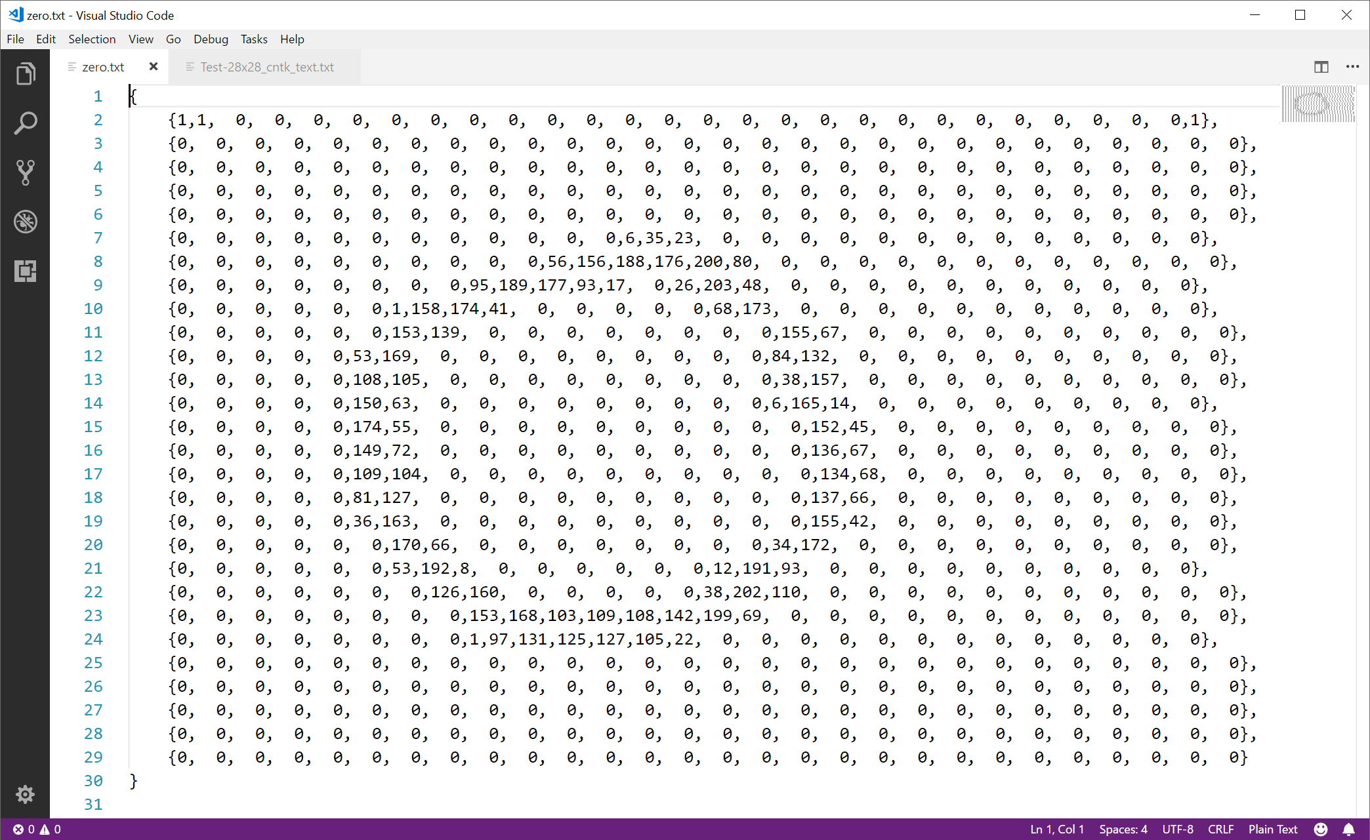

Slide 48
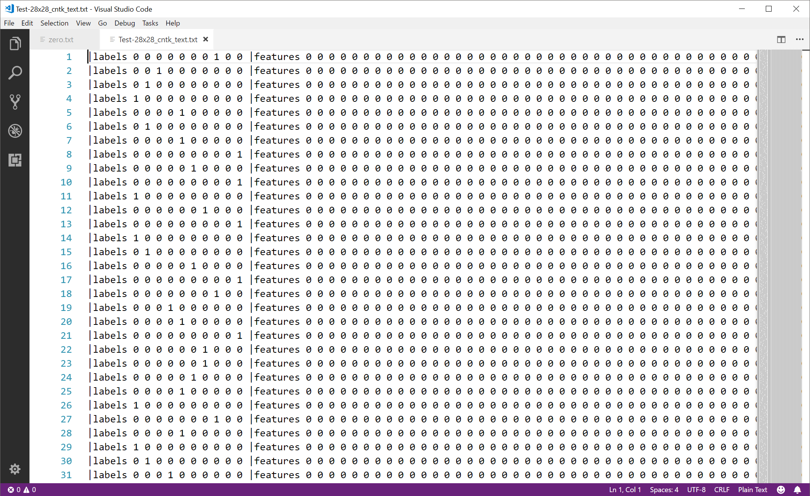

Slide 50
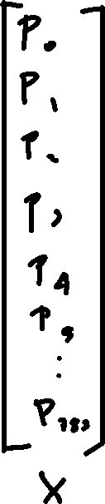
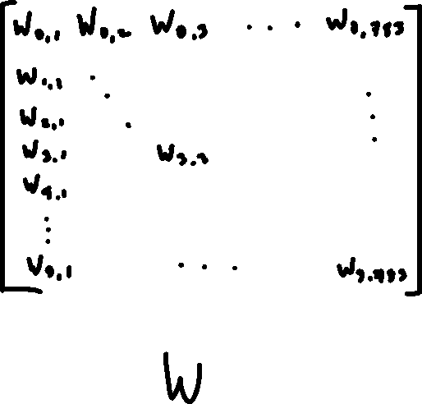
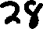


Slide 51
Let’s look – PART QUATRO!
It’s basically the same but with a bigger Tensors

Slide 53


Slide 54
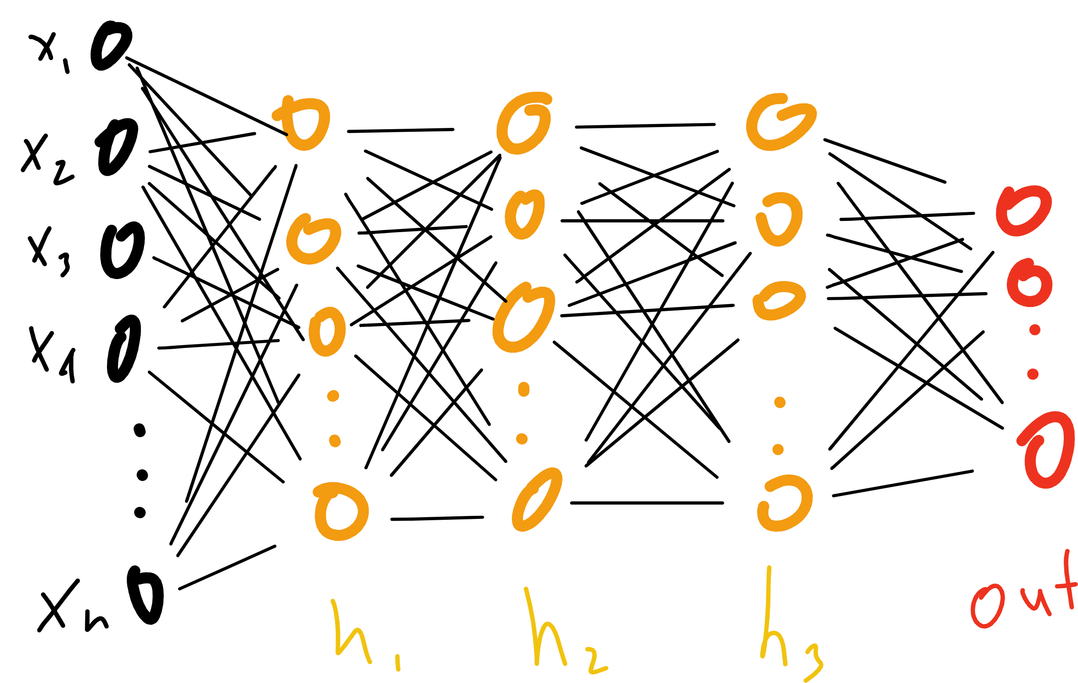

Slide 55


Slide 56
Notes:
Proof by induction

Slide 57
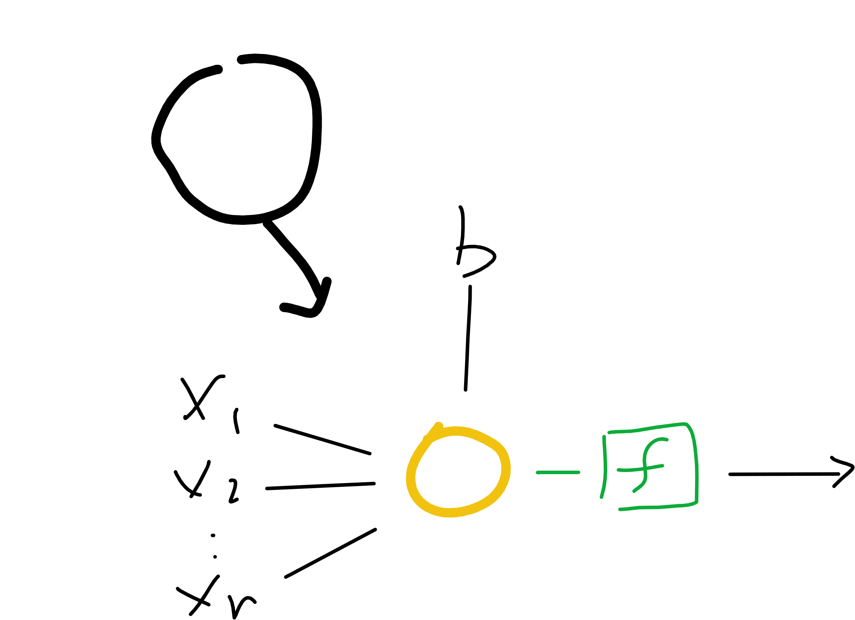
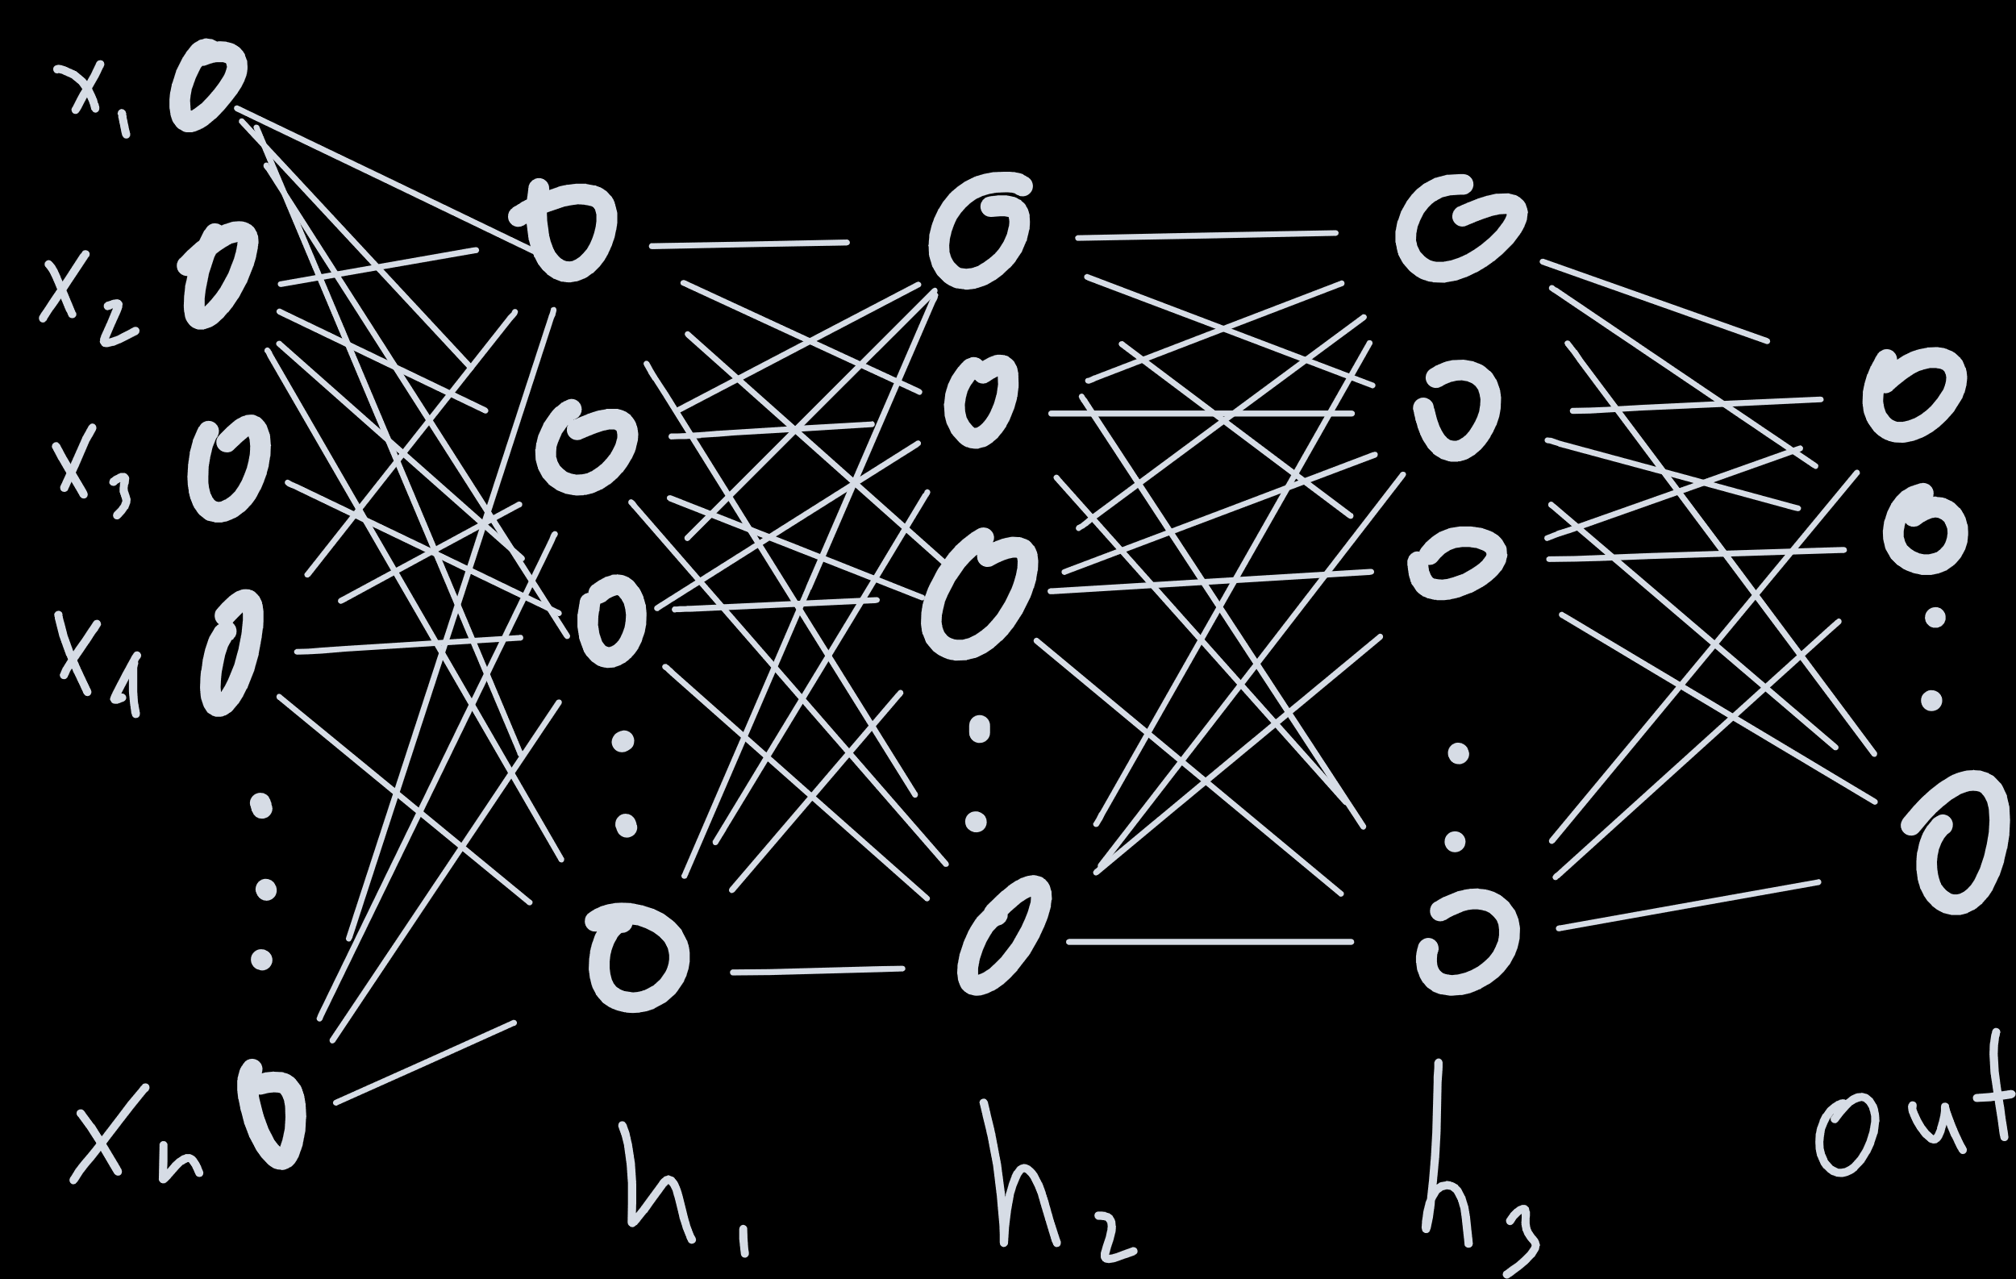
Notes:
Proof by induction

Slide 58
Notes:
Proof by induction

Slide 59
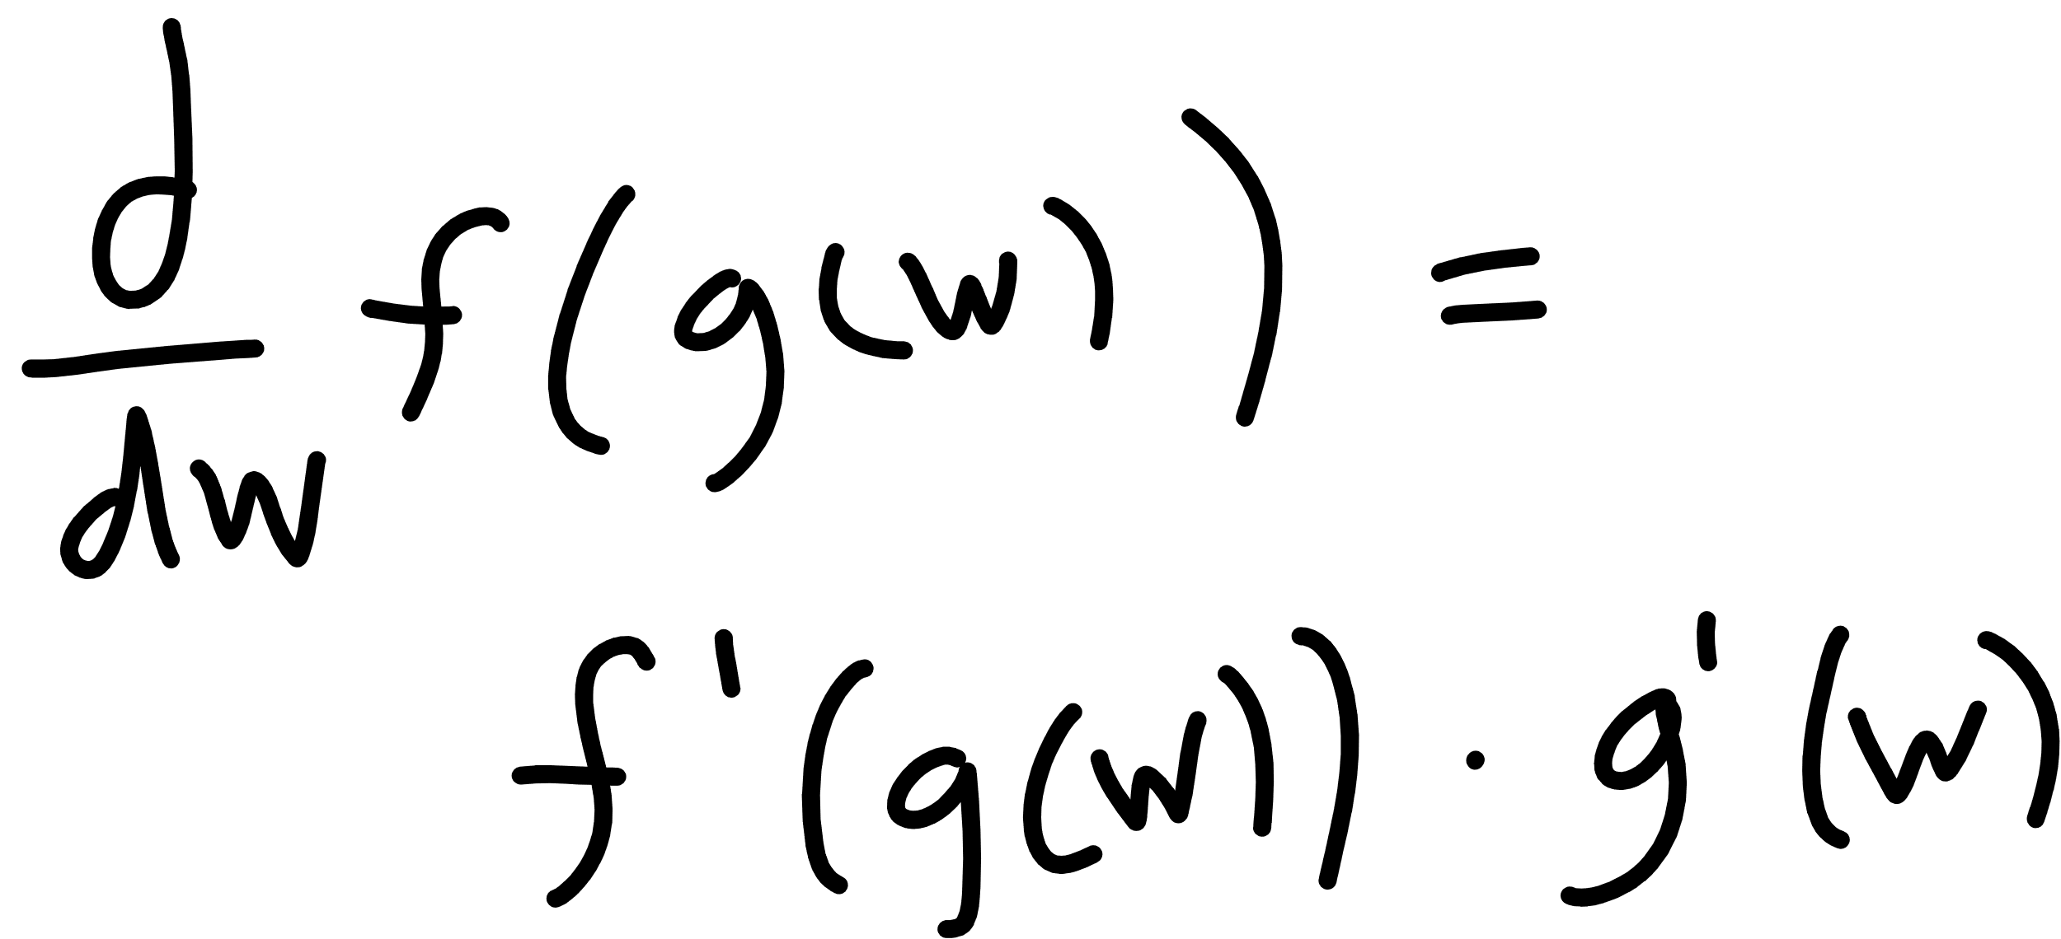

Slide 60
Notes:
Derivative?
Architecture

Slide 61
autograd
magic sauce

Slide 62
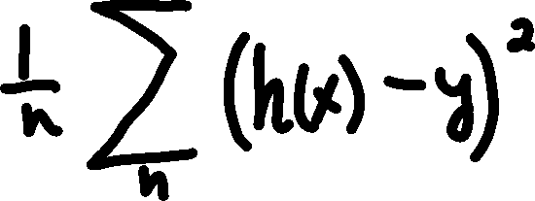













graph

Slide 63
make it!!
a full run through to production

Slide 64
summary
understanding the learning process
input (x, y)
model function (linear, mlp, cnn)
cost function (mean squared error, cross entropy loss)
optimization method (gradient descent, adam)
PyTorch
Tensors
DataSets
DataLoaders
Networks
Autograd

Slide 65
summary
Learn more about
Microsoft AI – https://aka.ms/aidevdocs
Cognitive Services – https://aka.ms/cogsvcs
Azure ML – https://aka.ms/azuremldocs
Deep Learning VMs – https://aka.ms/dlvmdocs
Batch AI – https://aka.ms/batchaidocs
Code
https://github.com/sethjuarez/Digitz
Get a hold of me!
seth.juarez@microsoft.com
@sethjuarez

Slide 66

Seth Juarez
Microsoft
@sethjuarez

